Slide 1
MSDS 7333: Quantifying the World
Week 10

Slide 2
Refresher on missing Data
Get the file download
Remember your group
Find the missing data for your group's data
MCAR
MAR
Monotone
Be prepared to explain to the class

Slide 3
Questions on the assignment
Ask now!
Or later

Slide 4
Background on MCMC
Monte Carlo Markov Chains
Two ideas coupled together
Implement a ‘smart sampling’
Reproduce a distribution
Bayesian Statistics

Slide 5
What is Monte Carlo?
Random Sampling.
“Throwing darts” and counting
Completely random data
Measurement function
Count using measurement
Think numerical integration

Slide 6

What is the value of $π$
If I have a random point x,y then by distance I can determine if a point is inside or outside the circle.
1
n=0
a=300000
for i in range(a):
x=np.random.uniform(-1,1)
y=np.random.uniform(-1,1)
r=np.sqrt(x*x+y*y)
if r<1:
n=n+1
print(n*a)
~3.142053333333333

Slide 7
Markov Chains
Think ‘Random Walk’
Where you go next only depends on where you are now
No dependence on where you have been
No memory
My next location (Blue arrows) depends only on my current location (blue dot).
Where I came from (red) has no impact

Slide 8
Markov Chains (cont.)
Often thought of as states
Connected to normal distributions
P(85%)
P(40%)
P(40%)
Sunny
Cloudy
P(10%)
P(20%)
P(20%)
P(5%)
P(60%)
Rainy
P(20%)

Slide 9
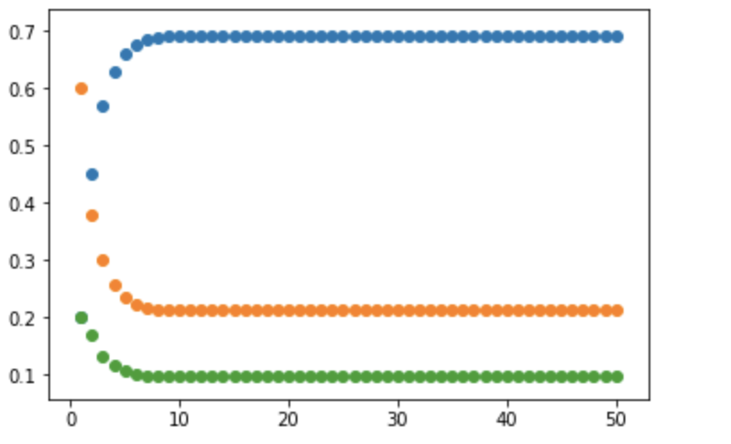
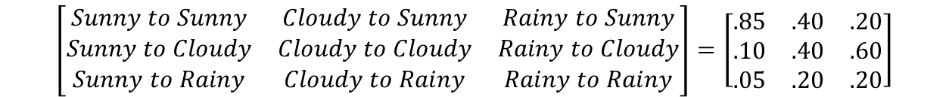
Make Some Math
$$\left[\begin{matrix}Sunny to Sunny & Cloudy to Sunny & Rainy to Sunny \\ Sunny to Cloudy & Cloudy to Cloudy & Rainy to Cloudy \\ Sunny to Rainy & Cloudy to Rainy & Rainy to Rainy\end{matrix}\right]=\left[\begin{matrix}.85 & .40 & .20 \\ .10 & .40 & .60 \\ .05 & .20 & .20\end{matrix}\right]$$
Probability on day N is given by S^{N} which becomes stable at large N
no matter the starting state
Before values stabilize, the probabilities are in a state of BURN-IN
Probability
Day

Slide 10
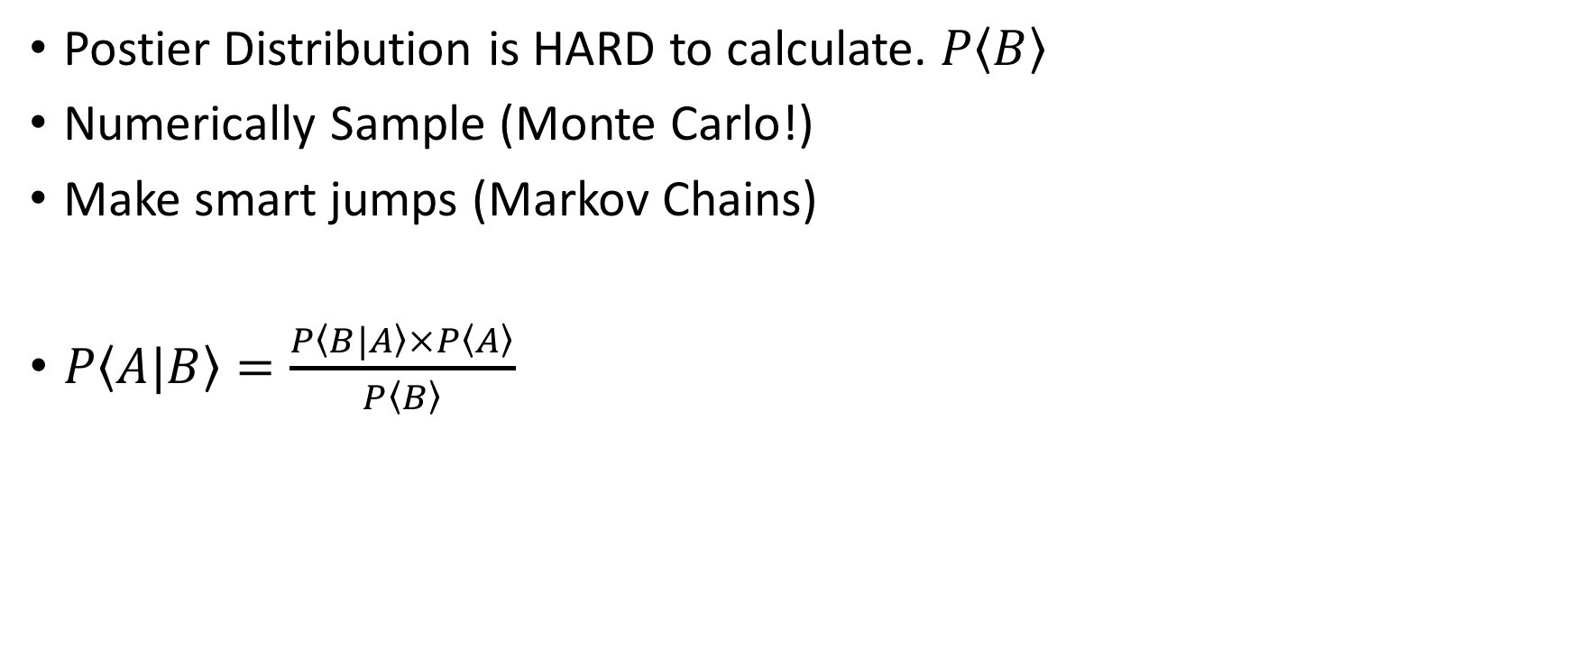
How does it work?
Postier Distribution is HARD to calculate. $P\left\langle B\right\rangle$
Numerically Sample (Monte Carlo!)
Make smart jumps (Markov Chains)
$P\left\langle A|B\right\rangle =\frac{P\left\langle B|A\right\rangle ×P\left\langle A\right\rangle }{P\left\langle B\right\rangle }$

Slide 11
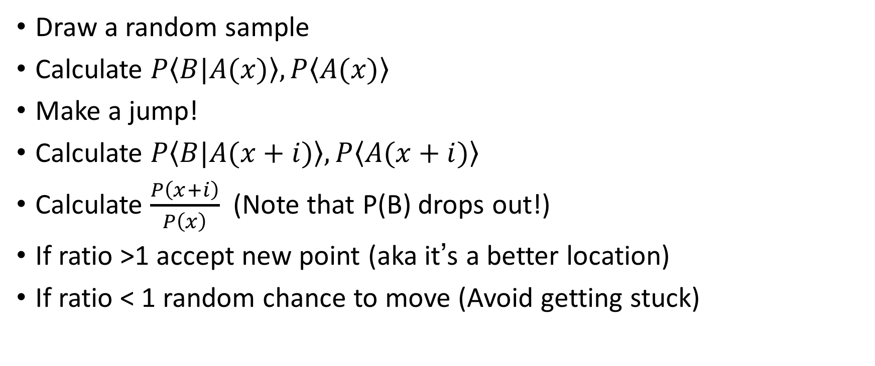
Hastings Metropolis Method
Draw a random sample
Calculate $P\left\langle B|A(x)\right\rangle ,P\left\langle A(x)\right\rangle$
Make a jump!
Calculate $P\left\langle B|A(x+i)\right\rangle ,P\left\langle A(x+i)\right\rangle$
Calculate $\frac{P\left(x+i\right)}{P\left(x\right)}$ (Note that P(B) drops out!)
If ratio >1 accept new point (aka it’s a better location)
If ratio < 1 random chance to move (Avoid getting stuck)

